Slide 1

COVID-19 ANALYSIS USING TABLEAU

Slide 2


The data has been taken from Kaggle and from official website of MOH, which maintains, tracks & updates Covid-19 data on a regular basis.
The covid_19_data contains information about confirmed, deaths and recovered cases country wise.
The covid_19_India (Vaccine Status) contains data about the vaccination status i.e. (First, Second and Total does) state wise
The vaccination-data _international contains data about vaccination status and total number of vaccines used country wise
ABOUT DATA SET

Slide 3

Total no. of confirmed cases in different nations
Total No. of Recovered cases in different nation
Confirmed cases in India in all States
Recovery cases in India in all states
Forecast trend for covid19 for international level
Forecast trend for covid19 for India
Top 10 Highest mortality rates at international level
Confirmed, Death and Recovery status of Top 5 countries
Vaccination status across states
Fully vaccinated Top and Bottom 5 states in India
Total Vaccinations and vaccines used Country wise
Top and Bottom 5 countries – Total Vaccinations
Covid – 19 Dashboard India
Covid – 19 Dashboard International
Covid – 19 STORY
TOPICS COVERED

Slide 4
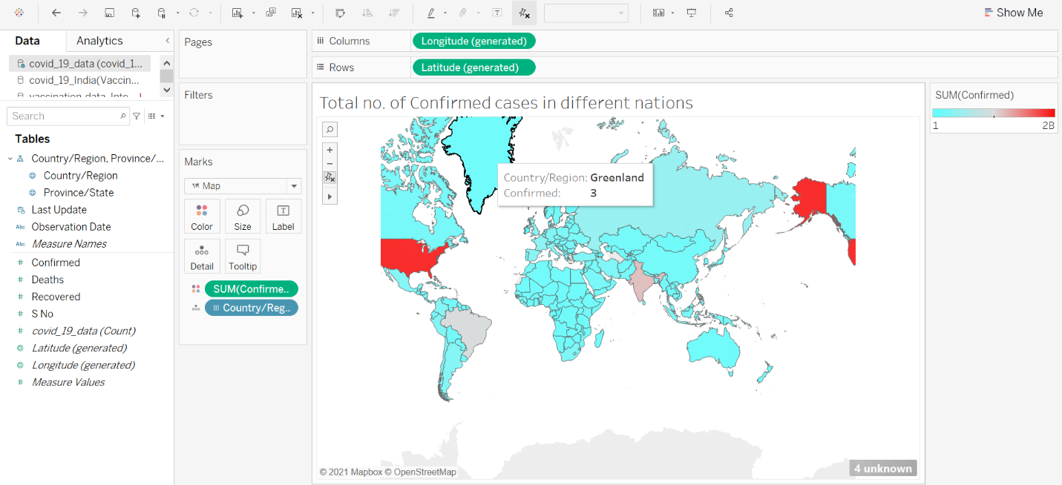
TOTAL NO. OF CONFIRMED CASES IN DIFFERENT NATIONS
Using Map chart, we have analyzed confirmed cases in different nations
Maximum cases here is being represented by red color and minimum by Light blue color
As we can observe that US, India and Brazil have considerably higher no. of cases

Slide 5
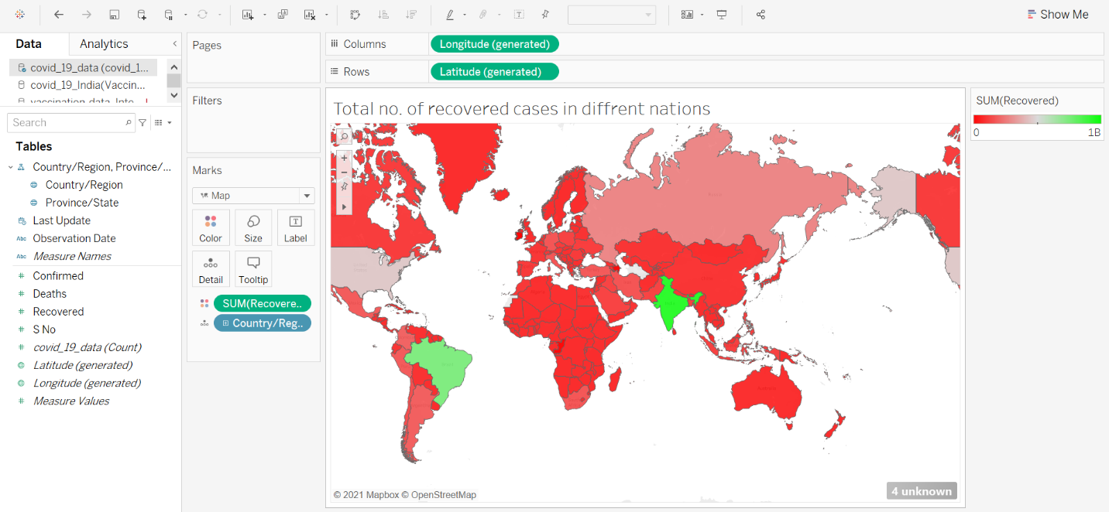
Total No. of Recovered cases in different nation
Using Map chart, we have analyzed Recovery cases in different nations
Maximum recovered cases here is being represented by green color and minimum by red color
As we can observe that India and Brazil have considerably higher no. of recovered cases

Slide 6
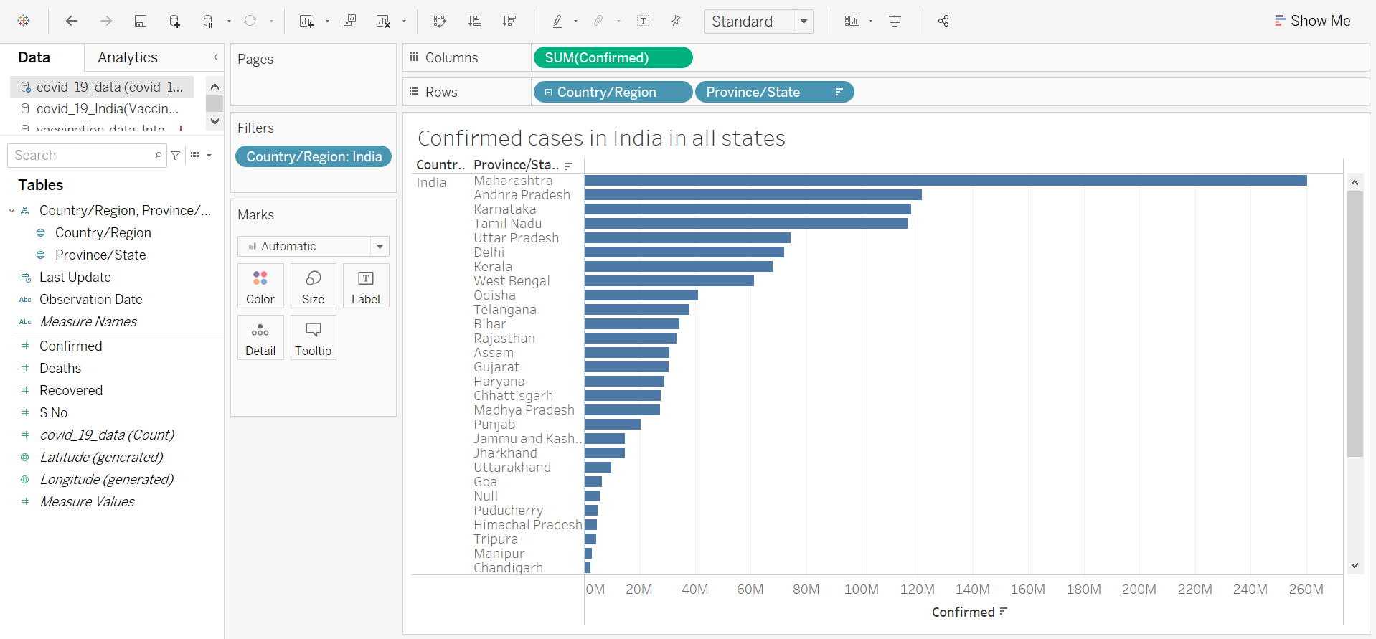
Confirmed cases in India in all States
Using Horizontal bars, we have analyzed Confirmed cases in different states of India
As we can observe Maharashtra has Maximum no. of cases among all states
As we can observe Lakshadweep has Minimum no. of cases among all states

Slide 7
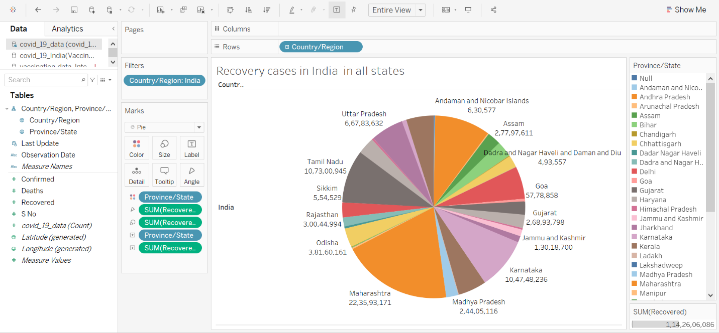
Recovery cases in India in all states
Using Pie chart and filter method, we have analyzed Recovery cases in different states of India
As we can observe Maharashtra has Maximum no. of recovered cases among all states
As we can observe Mizoram has Minimum no. of recovered cases among all states

Slide 8
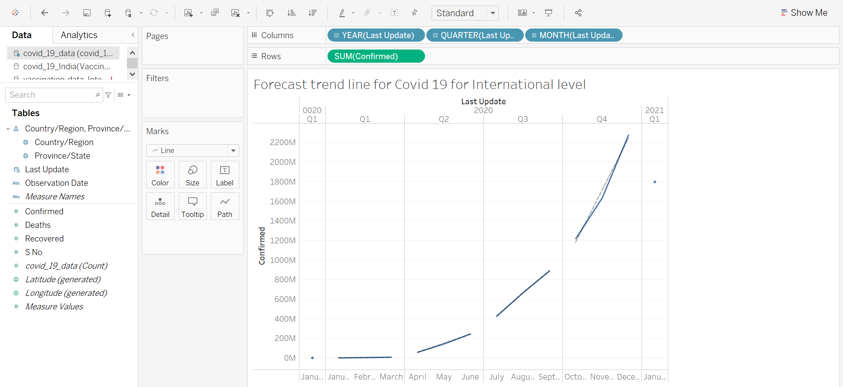
Forecast trend for covid19 for international level
Using Trend line and Line chart, we have Forecasted rate of Covid19 at International level
As we can observe in January 2021, Covid cases would decrease to 1,79,69,14,935.
It reads R square and P values for creating the trend line

Slide 9
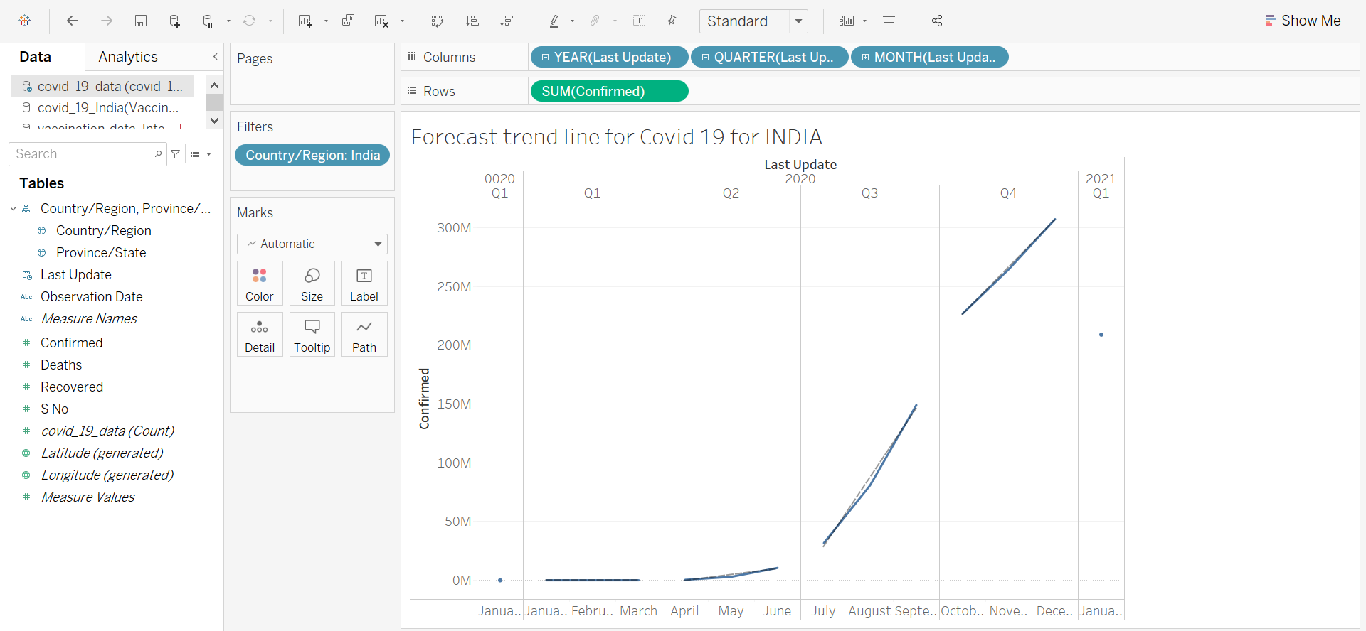
Forecast trend for covid19 for India
Using Trend line and Line chart, we have Forecasted rate of Covid19 for India.
As we can observe in January 2021, Covid cases would decrease to 20,89,52,747.
It reads R square and P values for creating the trend line

Slide 10
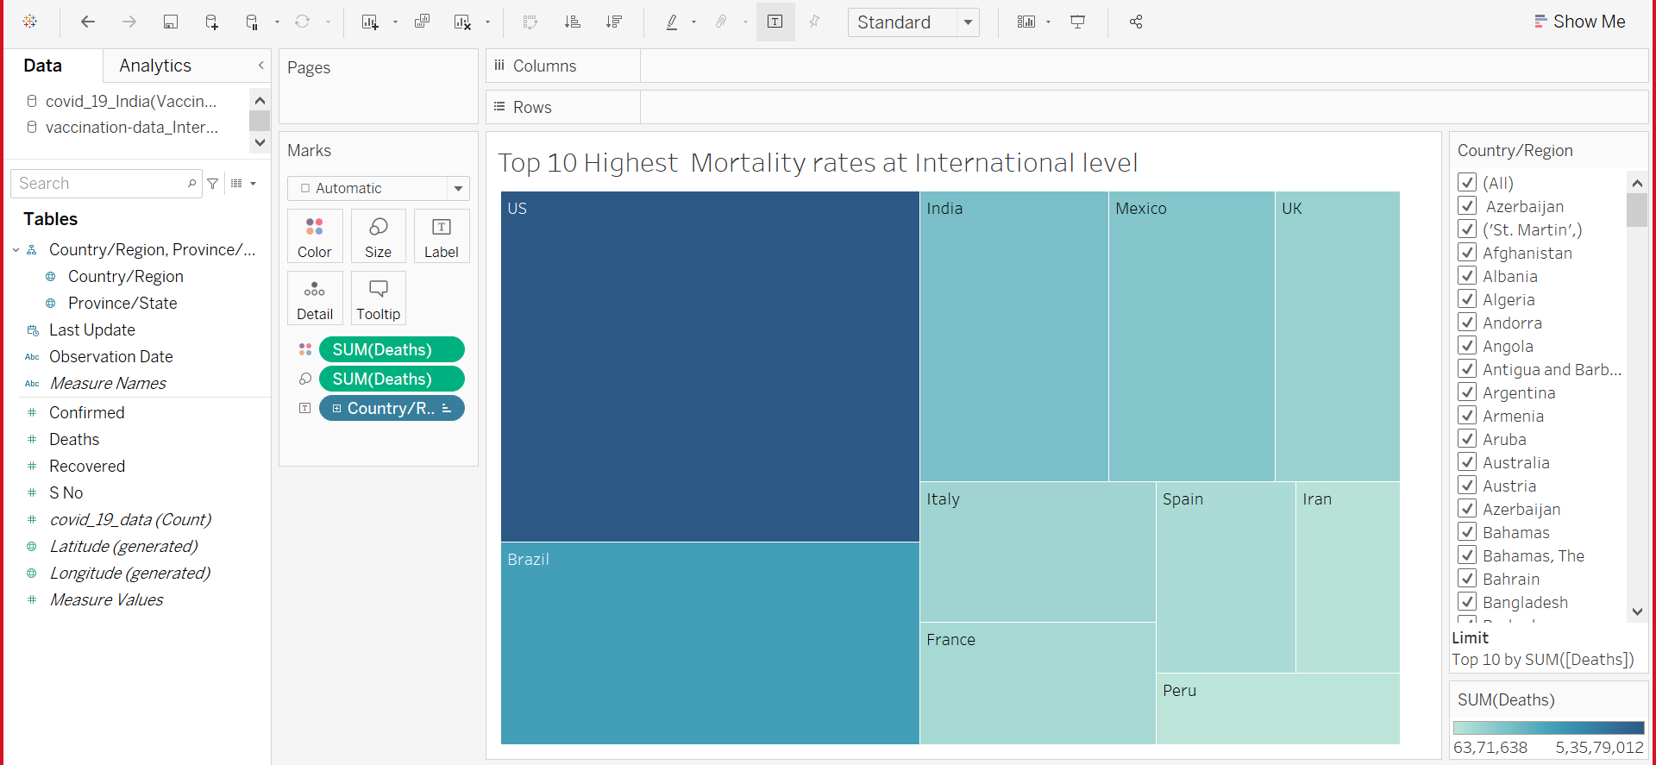
Top 10 Highest mortality rates at international level
Using Tree map, we have analyzed Mortality rate of top 10 countries
As we can observe US has the highest mortality rate among the top 10 also.
As we can observe Peru has the lowest mortality rate among the top 10.

Slide 11
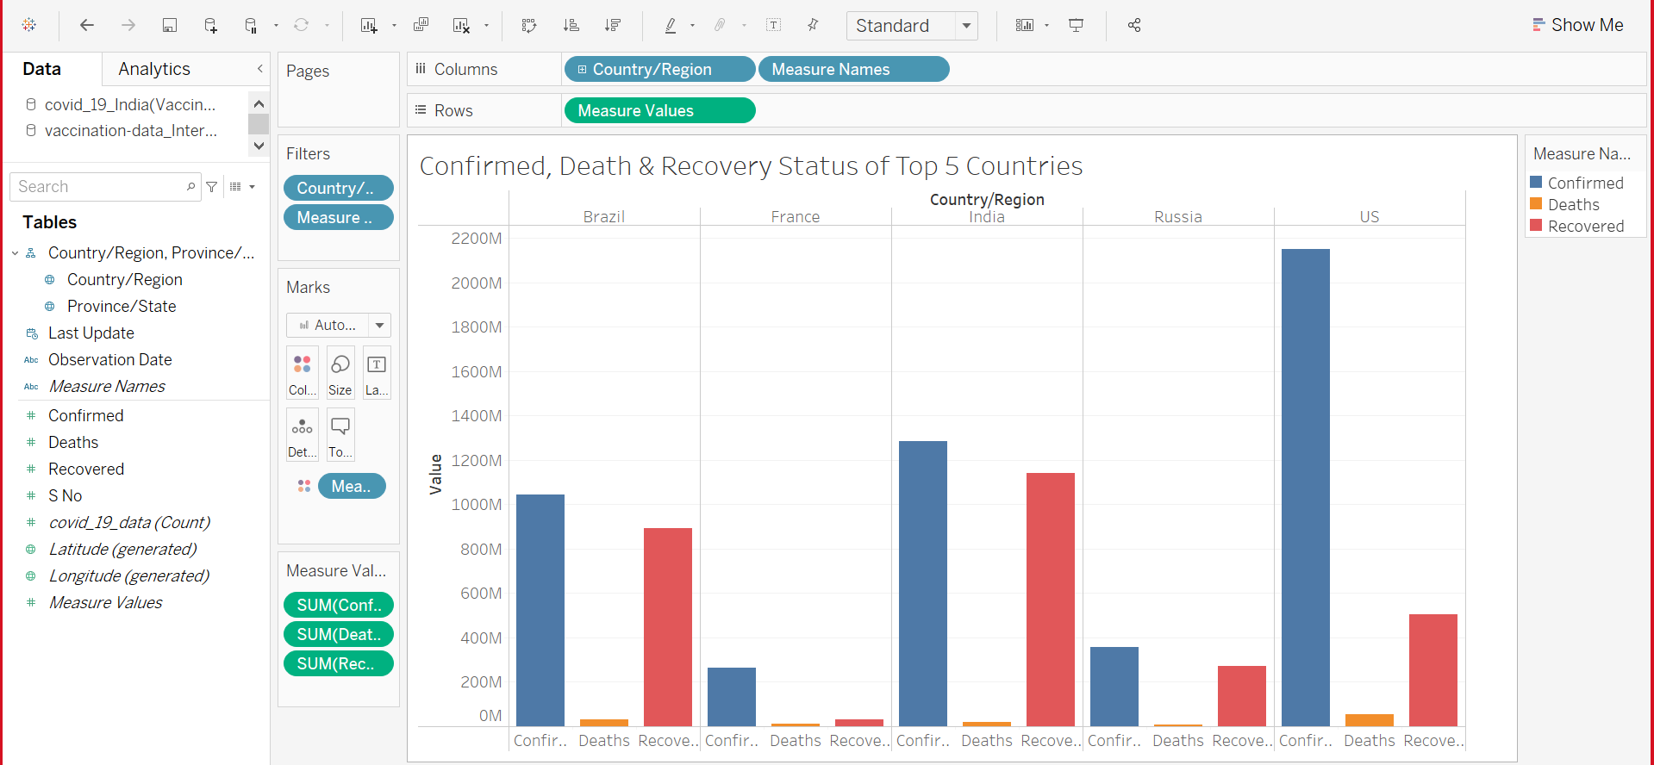
Confirmed, Death and Recovery status of Top 5 countries
Using side by side bars, we have analyzed Confirmed , Death and Recovery status of top 5 countries
As we can observe US has the highest Deaths and Confirmed cases
As we can observe India has the highest recovery cases

Slide 12
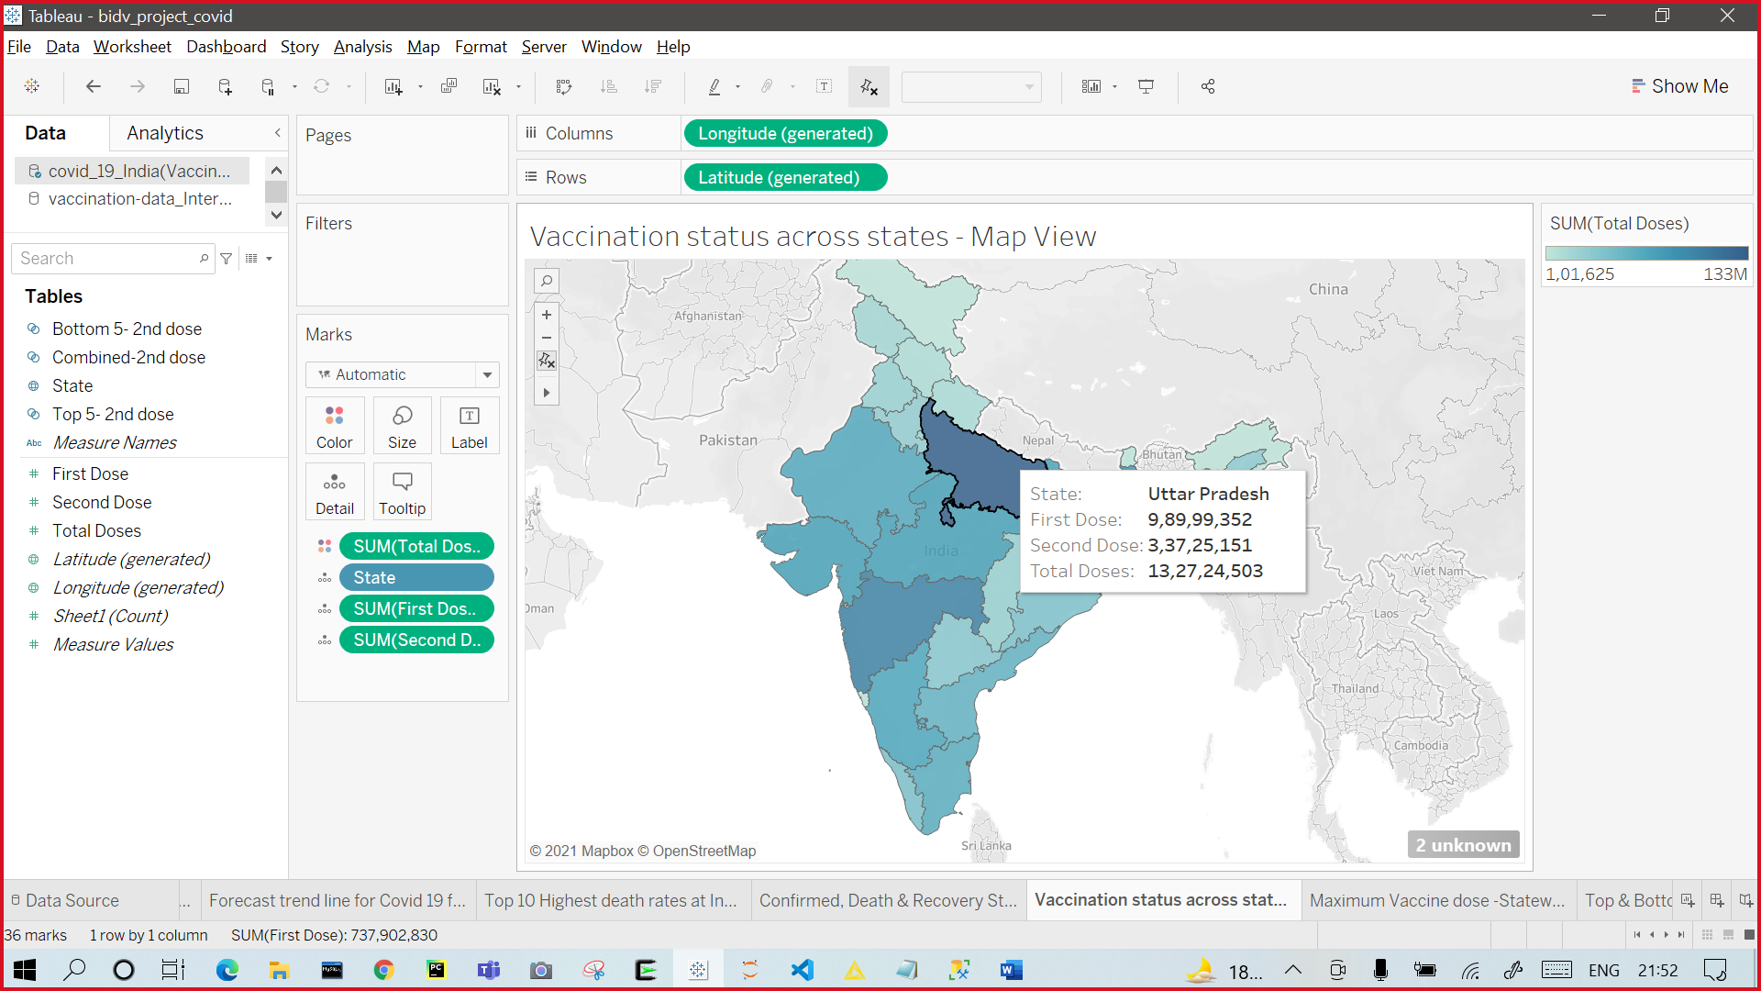
Vaccination status across states
Using Map view, we have analyzed vaccination status (first dose, second dose and total dose) state wise in India.
As we can observe Uttar Pradesh has the highest number of doses which is 13,27,24,503.
As we can observe Lakshadweep has the lowest number of doses.

Slide 13
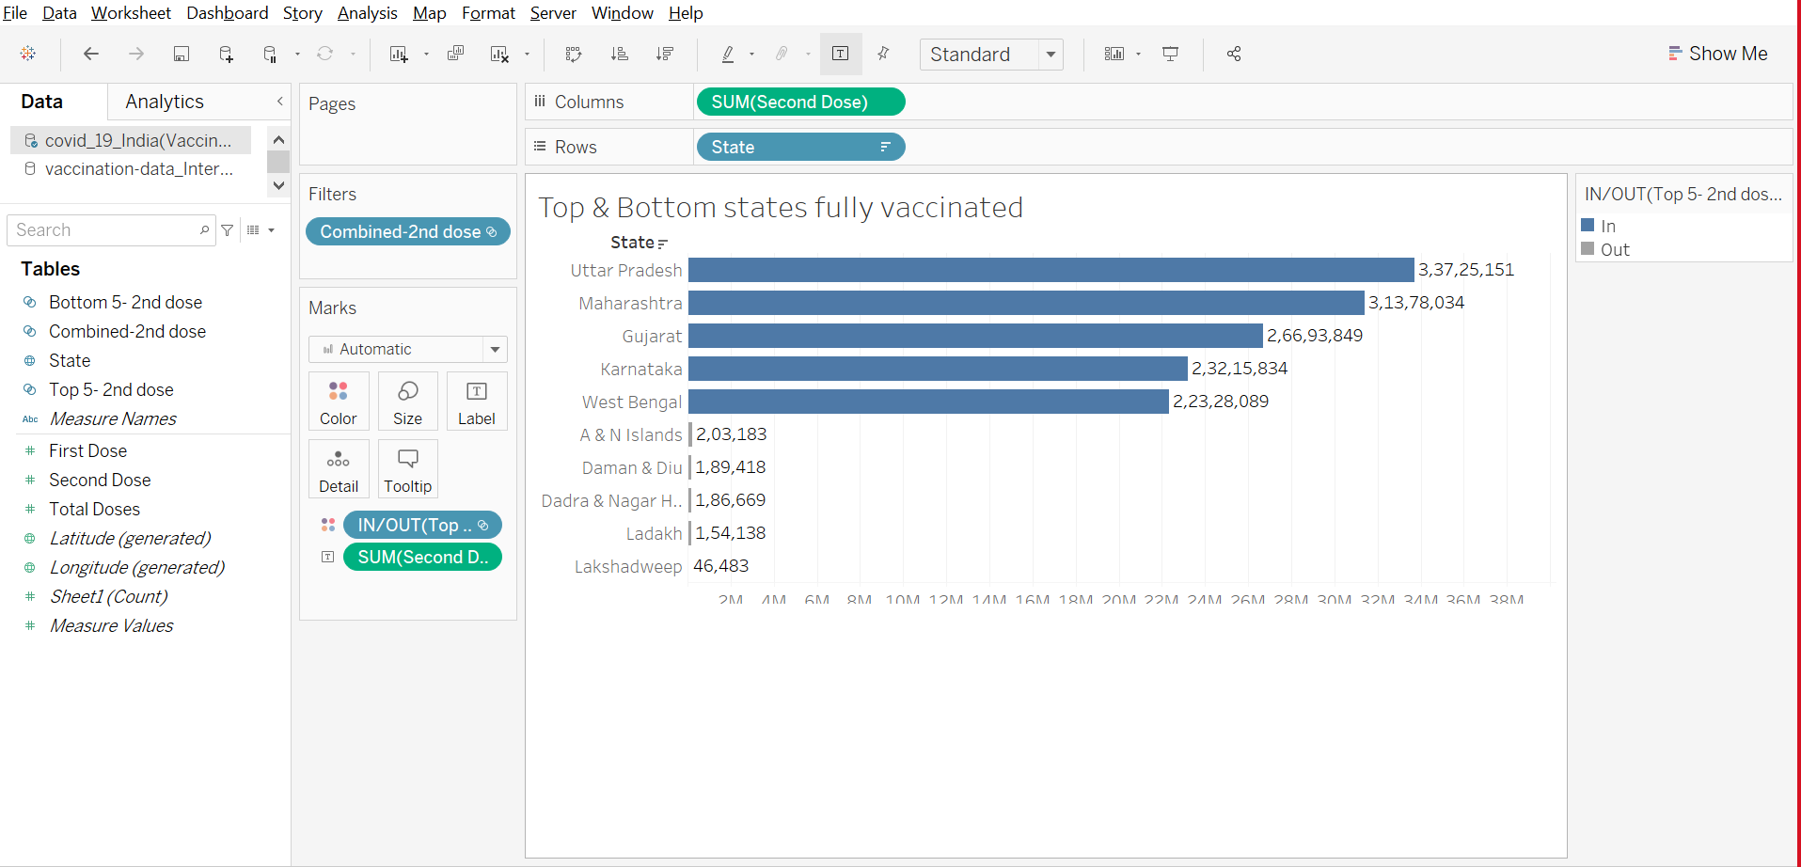
Fully vaccinated Top and Bottom 5 states in India
Using Concept of Sets, we have analyzed top and bottom fully vaccinated states in India
As we can observe Uttar Pradesh has the highest number of Second doses which is 3,75,25,151
As we can observe Lakshadweep has the lowest number of Second doses which is 46,483.

Slide 14
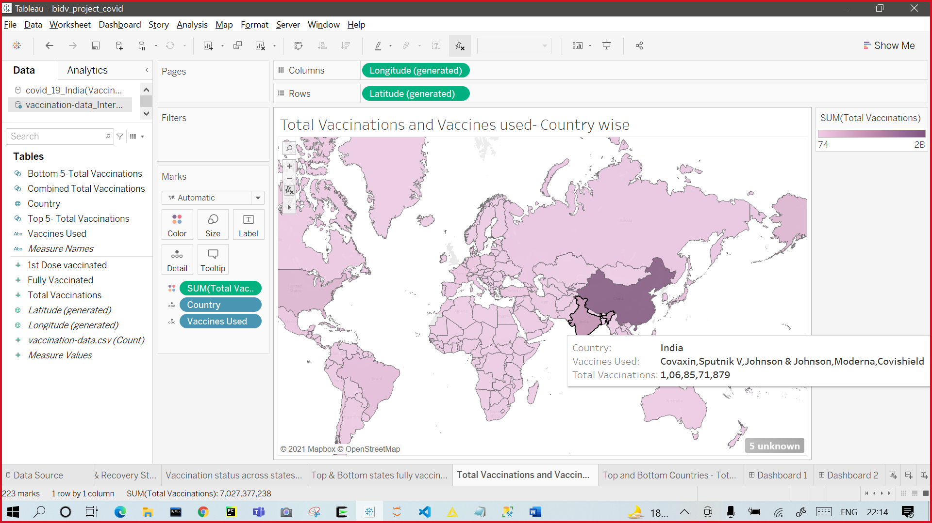
Total Vaccinations and vaccines used Country wise
We have created a map showing vaccine type and total vaccination does country wise
Map shows vaccines available in a country when you hover over it
As we can see maximum vaccines used were from China.

Slide 15
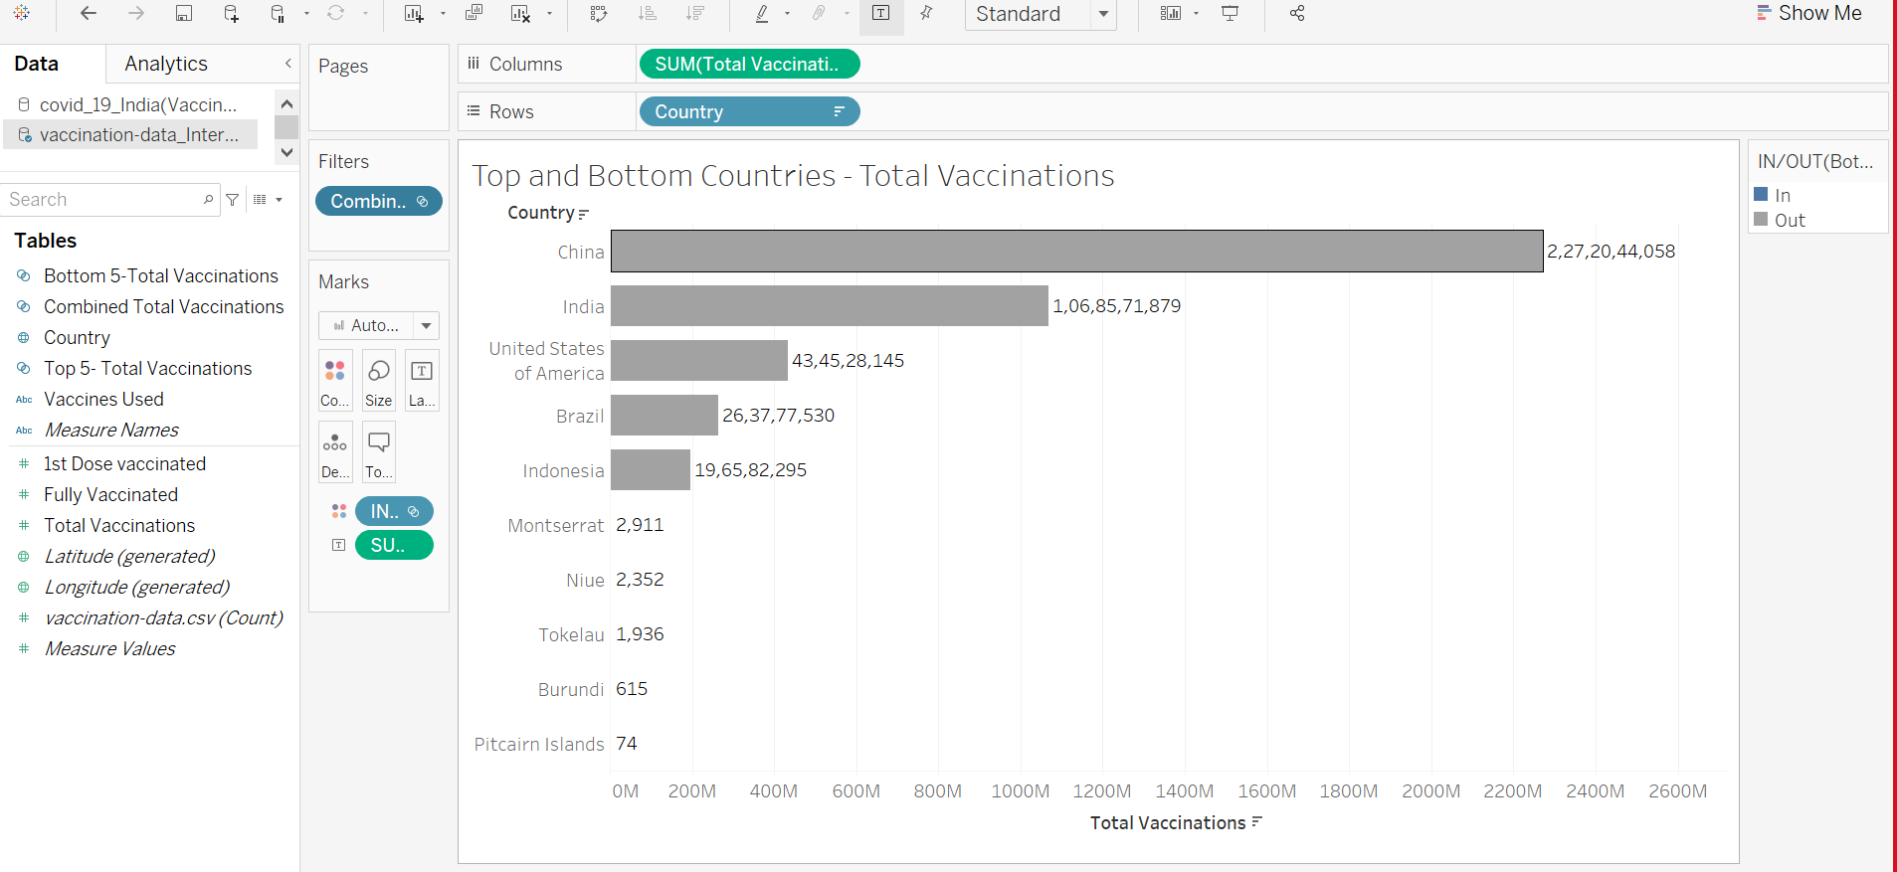
Top and Bottom 5 countries – Total Vaccinations
Using horizontal bar and concept of set we have analyzed top and bottom 5 countries total vaccination status.
As we can observe that China has the among the first set
In the second set of bottom five countries Pitcairn Islands has the lowest

Slide 16
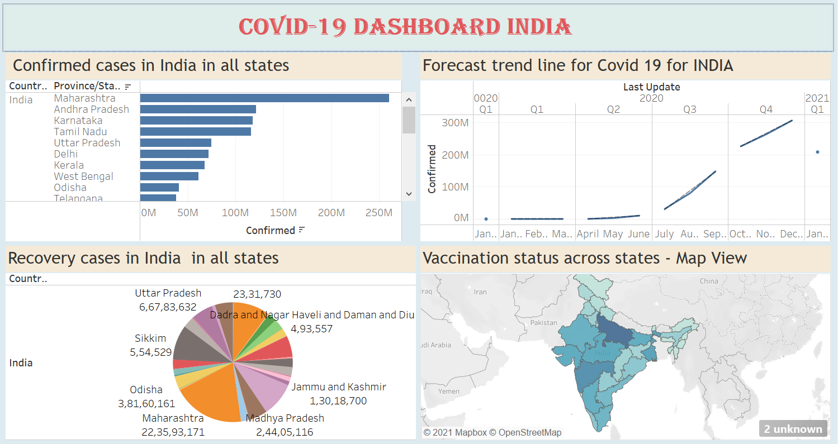
Covid – 19 Dashboard India
A dashboard for India, representing Recovery cases, confirmed cases, vaccination status and the forecast trend line

Slide 17
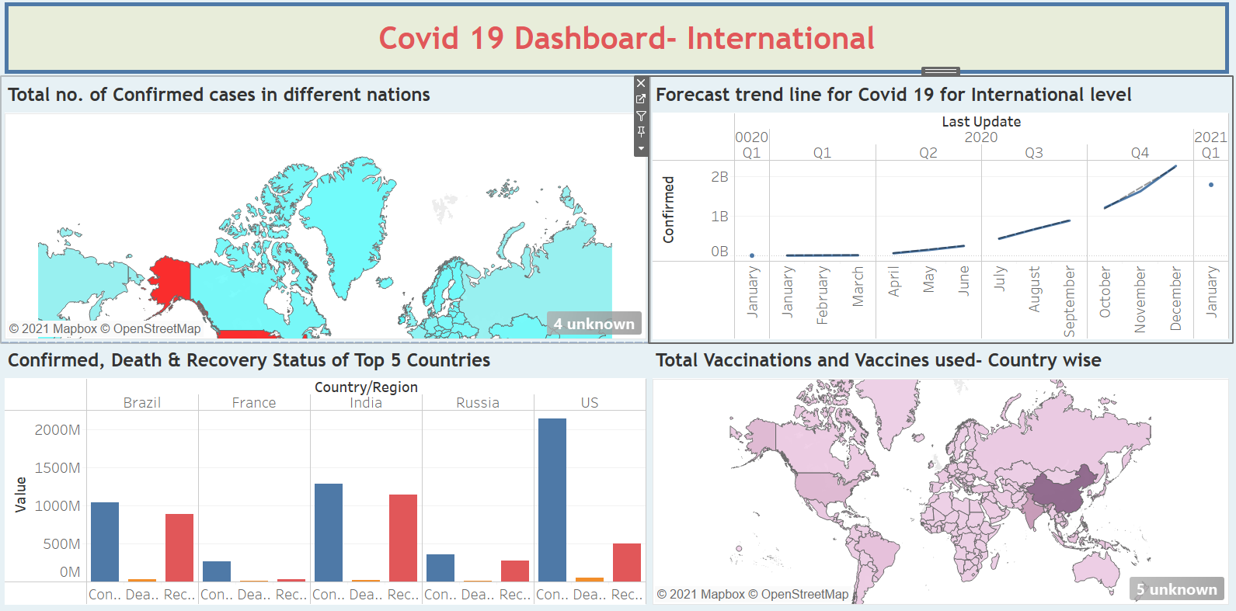
Covid – 19 Dashboard International
A dashboard for international level, representing Recovery cases, confirmed cases, death cases, vaccination status and the forecast trend line

Slide 18
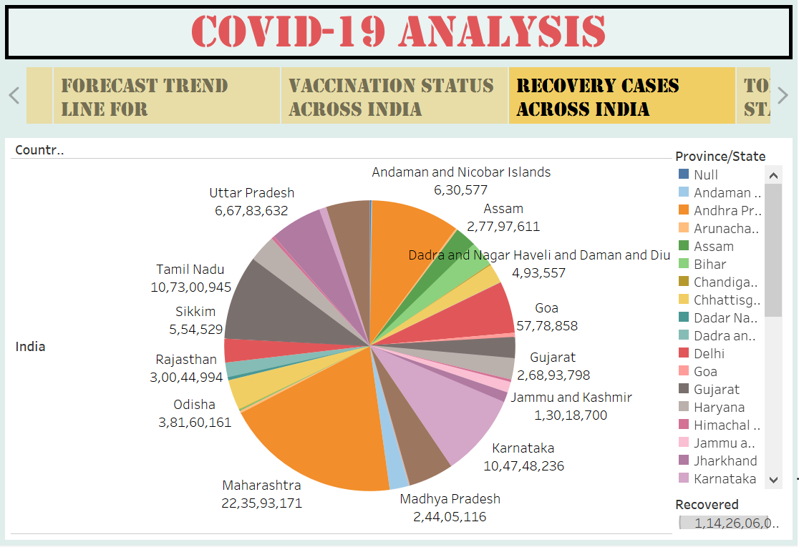
Covid – 19 STORY
A Story for representing almost everything like Recovery cases, confirmed cases, death cases, vaccination status and the forecast trend line

Slide 19
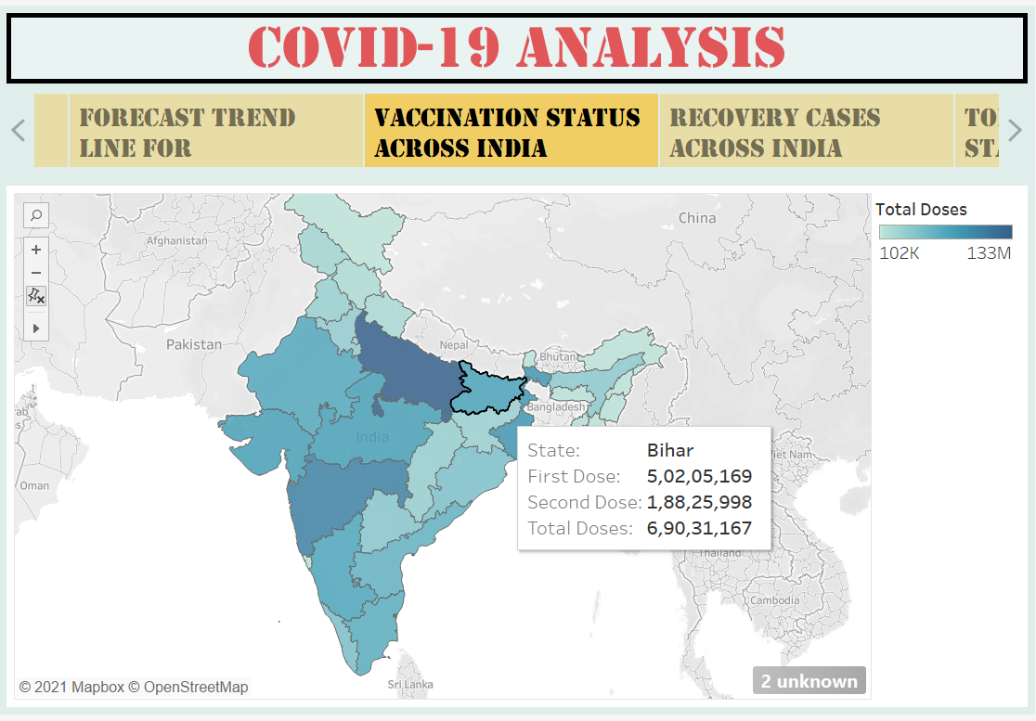
Covid – 19 STORY
A Story for representing almost everything like Recovery cases, confirmed cases, death cases, vaccination status and the forecast trend line

